Slide 1

Task 1:
Mobile App Development Process
BY GROUP 3

Slide 2
Mobile App Development
Mobile app development is a rapidly evolving field crucial for modern digital solutions. This presentation explores key aspects like app types, programming languages, frameworks, architectures, requirement engineering, and cost estimation. Understanding these elements enables developers to create high-quality, efficient, and user-friendly mobile applications.

Slide 3

Understanding Mobile Applications
What is a Mobile App?
Types of Mobile Apps
A mobile app is a software application developed for small, wireless computing devices like smartphones and tablets, rather than desktop or laptop computers. Mobile apps are designed to provide a wide range of functions and services with consideration for the demands, constraints, and capabilities of the devices they're built for.
Native apps are designed for specific mobile operating systems like Android or iOS.
Web apps are optimized for mobile devices and accessible through a web browser.
Hybrid apps combine elements of both native and web apps, using a single codebase to run on multiple platforms.
Progressive Web Apps (PWAs) are web apps that provide a native app-like experience.

Slide 4




Mobile App Programming Languages
Mobile app programming languages are specialized coding languages used to develop applications for mobile devices like smartphones and tablets. These languages determine how an app functions, its performance, and its compatibility with different operating systems (iOS, Android, etc.). The different mobile app programming languages are:
Swift
Swift is a powerful and intuitive programming language for all Apple platforms, enhancing readability, speed, and performance.
Kotlin
Kotlin is a statically typed, object-oriented programming language interoperable with the Java virtual machine (JVM) and Android.
Java
Java is a transferable programming language used across platforms and devices, from smartphones to smart TVs.

Slide 5

Development Frameworks Explained
Web Frameworks
Mobile Development Frameworks
Designed for web application development, handling HTTP requests, database interactions, and user authentication.
Facilitate the creation of mobile applications for platforms like iOS and Android, such as Flutter and React Native.
Desktop Application Frameworks
Support the development of desktop applications across various operating systems, like Electron and Qt.
A software framework is a pre-established platform that provides a foundation for developing software applications. It offers a standard way to build and deploy applications by supplying a collection of pre-written code, components, and tools.

Slide 6
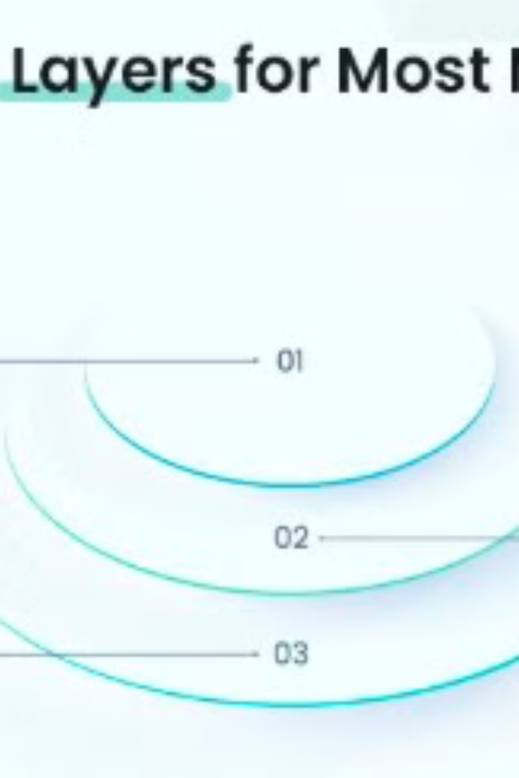



Mobile App Architectures
Presentation Layer
Defines how an application will be presented to the end users, including the user interface and communication layer.
Business Layer
Provides a set of rules and algorithms that manage the flow of data in the context of a business.
Data Layer
Ensures the transfer and receipt of data seamlessly, consisting of service agents, data access components, and data utilities.
Mobile app architecture is a combination of model/design and techniques used to build a mobile application ecosystem. It functions as the blueprint for a mobile application that will take shape according to the architecture.

Slide 7



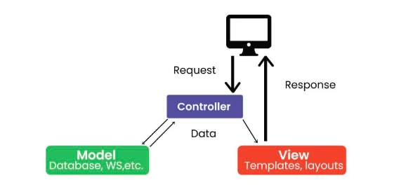
Design Patterns for Mobile Development
MVP
2
Similar to MVC but puts more responsibility on the Presenter to manage the interaction between Model and View.
MVC
Separates an application into Model, View, and Controller for better code design and modularization.
1
3
MVVM
Separates the application into Model, View, and ViewModel, widely used in frameworks like Android’s Jetpack.
Design patterns are reusable solutions to common software development problems. They have had a significant impact on software development, including mobile app development. The implementation of mobile apps has established some proven models and standards to overcome the challenges and limitations of mobile app development.

Slide 8
The Requirements Engineering Process
Elicitation
1
Gathering information about the needs and expectations of stakeholders.
Specification
2
Documenting the requirements in a clear, consistent, and unambiguous manner.
Validation
3
Checking that the requirements are complete, consistent, and accurate.
Requirements engineering is the systematic and strict approach to the definition, creation, and verification of requirements for a software system. To guarantee the effective creation of a software product, the requirements engineering process entails several tasks that help in understanding, recording, and managing the demands of stakeholders.

Slide 9

Mobile App Development Cost Estimation
Understanding the costs involved in mobile app development is crucial for budgeting and planning. Let's break down the different stages of a mobile app development project to understand how costs are formed.
From initial discovery to ongoing maintenance, each phase contributes to the overall cost. Factors such as development method, customization, and required expertise play significant roles in determining the final price.

Slide 10
Stages of App Development and Their Costs
Discovery
App Design (UI/UX)
Development & Infrastructure
Understanding the app's purpose, user engagement, and business needs. Market and user research are conducted. Cost: $1,000 - $10,000.
Creating engaging and intuitive user experiences. Includes wireframes, mockups, and user flows. Cost: $5,000 - $55,000.
Coding the app, implementing features, integrating APIs and databases, and setting up the server. Cost: $2,000 - $60,000.

Slide 11
Development Methods: Coding vs. No-Code vs. Low-Code
Traditional Coding
No-Code Development
Low-Code Development
Involves writing code from scratch using programming languages, offering maximum customization but requiring skilled developers.
Enables the creation of functional apps without extensive coding knowledge, reducing costs and time to market.
Streamlines the development process with visual interfaces and some coding flexibility, balancing cost and customization.
When it comes to app development, there are different approaches to consider. Each method has its own advantages and considerations in terms of time, cost, and technical expertise required.

Slide 12

Conclusion: Mastering Mobile App Development
App Types
Programming Languages
Understanding native, hybrid, and progressive web apps.
Selecting the right language impacts development speed and scalability.
Architecture
Requirement and Cost Estimation
Ensuring maintainability and efficiency with a well-structured architecture.
carefully select achievable requirement with proper cost estimation
The mobile app development process involves several crucial aspects, including app types, programming languages, frameworks, architectures, requirement engineering, and cost estimation. Mastering these elements enables developers to create high-quality, efficient, and user-friendly mobile apps.

